Slide 1


CAPSTONE PROJECT
Outpatient Schedule Tracking
Routhu Rambabu
Simple Solutions!

Slide 2
Project Overview
Introduction : "Sarvotham's Spine Care," a growing hospital in Bengaluru, experiencing an increase in patient volume. While they have an effective support system, their current processes for managing outpatient schedules, records, and billing are maintained manually in physical registers. This manual process is inefficient and hinders productivity. The hospital seeks a digital solution to streamline these operations
Project Goal : The primary goal is to develop a digital application that allows the hospital to effectively manage and track every outpatient's schedule. This system will enhance the productivity of the hospital staff and enable attending physicians and nurses to manage patients more efficiently.
Simple Solutions!

Slide 3
Scope :
Front Desk Management : A digital kiosk to manage patient alignment with doctors, track patient status, and redirect requests to appropriate support staff.
Support Staff Operations : A system for nurses, attenders, and lab technicians to update patient health information, upload diagnostic reports, and manage billing-related information like treatment fees.
Patient Portal : A secure portal for patients to register, view their treatment records, and access their bills and lab reports online.
Billing Management : A dedicated module for the billing desk to verify treatment types, generate bills, and process payments, including cash and claims-based transactions.
Simple Solutions!

Slide 4
Actors & Their Roles
Actor | Primary Responsibilities
Doctor | Review comprehensive patient history and diagnostic reports Provide diagnoses and treatment plans Prescribe medications and order lab tests or imaging Communicate clearly with patients and caregivers Approve and validate health records Record consultation notes and follow-up instructions Coordinate with support staff for continuous patient care Manage outpatient schedules and availability
Patient | Create and manage personal account credentials securely Register and update personal and insurance information View detailed treatment history and progress Access billing statements, payment history, and lab results digitally Receive notifications about appointments, test results, and billing Raise queries or support requests Maintain privacy settings and consent for data sharing
Simple Solutions!

Slide 5
Actors & Their Roles
Actor | Primary Responsibilities
Support Staff (Nurse / Attender / Lab Technician) | Preauthorization of Patient Admit patients: register patients Manage patient data and medical information during admission and stay. Submit and track insurance claims of Each patient Upload required medical bills, reports, and discharge summaries. Respond to queries or requests for medical documents.
Front Desk | Register and align patients with their specific doctors Track and update real-time status of patients (waiting, under consultation, completed, etc.) Redirect and escalate patient requests to the appropriate support staff promptly Manage appointment scheduling and rescheduling Verify patient identity and appointment details during check-in
Simple Solutions!

Slide 6
Actors & Their Roles
Actor | Primary Responsibilities
Billing Desk | Validate treatment codes and types prior to billing Generate accurate bills based on all treatments, investigations, and medicines Process payments via cash, credit, insurance claims, or other modes Manage billing disputes and queries Generate financial reports and audit trails Ensure compliance with regulatory and insurance requirements Coordinate with patients and insurance providers for claims processing
Simple Solutions!

Slide 7
System Architecture
Database (MongoDB):
1. Users and Roles: users, roles, and otps manage all user types and their permissions.
2. Patient Journey: patients, appointments, medical_records, prescriptions, nurse_checkups, diagnostic_tests, and doctors_rating cover the clinical patient experience.
3. Hospital Operations: doctors, doctor_availabilities, hospitals, rooms, and room_transfers handle staff and facility management.
4. Financial & Administrative: bills, bill_items, policies, hospital_claims, hospital_claim_queries, and notifications manage all billing and administrative data
Backend (Spring Boot Microservices):
REST APIs to manage data.
Frontend (React + MUI):
1. Responsive user interface for booking, transfer, notifications, docs upload, and Track Status.
2. Patient, Doctor ,Nurse , Billing Desk , Front Desk and Lab Technician dashboards for management tasks.
Simple Solutions!

Slide 8
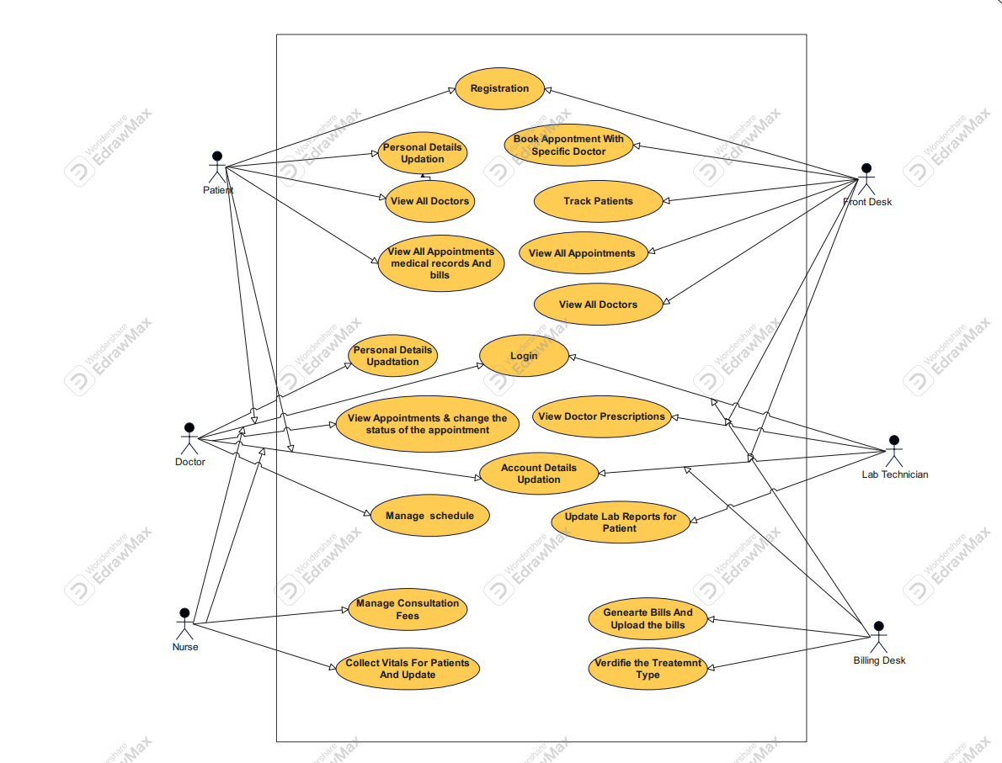
Use Case Diagram
Simple Solutions!

Slide 9
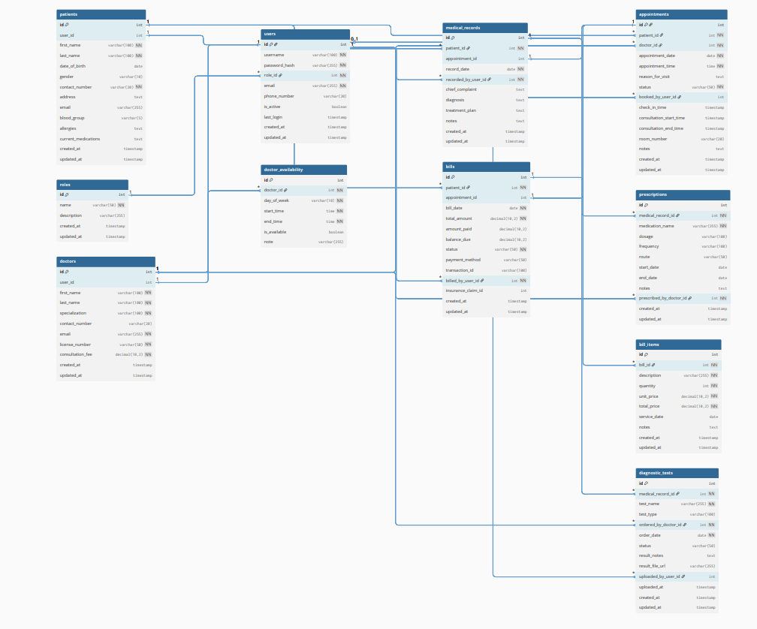
DB Diagram
Simple Solutions!

Slide 10
Documents
SRS
HLD
LLD
QSC
Test Reports
Github
Simple Solutions!

Slide 11
Technology stack
Frontend
React: A JavaScript library for building the user interface.
Material-UI (MUI): A popular React UI framework that provides pre-built, responsive components for the dashboards and other UI elements.
Backend
Spring Boot: A Java-based framework used to create stand-alone, production-grade applications.
Microservices: An architectural style where a single application is composed of small, independent services, each running in its own process. This allows for scalability and easier management of different application functions (e.g., a service for users, one for appointments, etc.).
REST APIs: The communication protocol used by the microservices to interact with both the frontend and each other.
Database
MongoDB: A NoSQL, document-based database used to store all your application data, including users, medical records, and claims.
Simple Solutions!

Slide 12
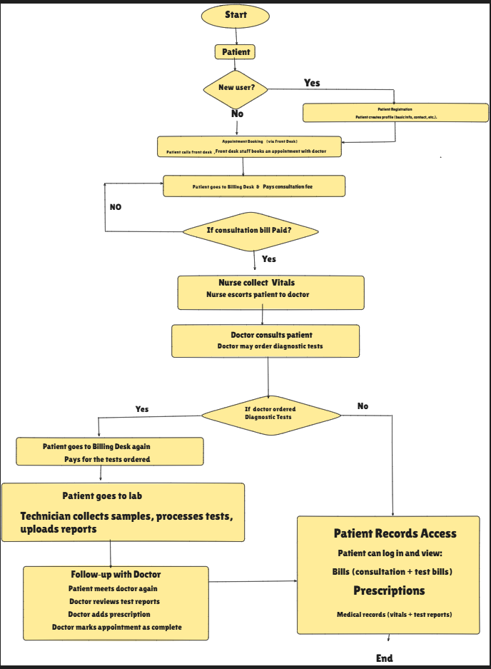
Flow Chart
Simple Solutions!

Slide 13

Q/A
Simple Solutions!

Slide 14
Thank You
Simple Solutions!

